Slide 1
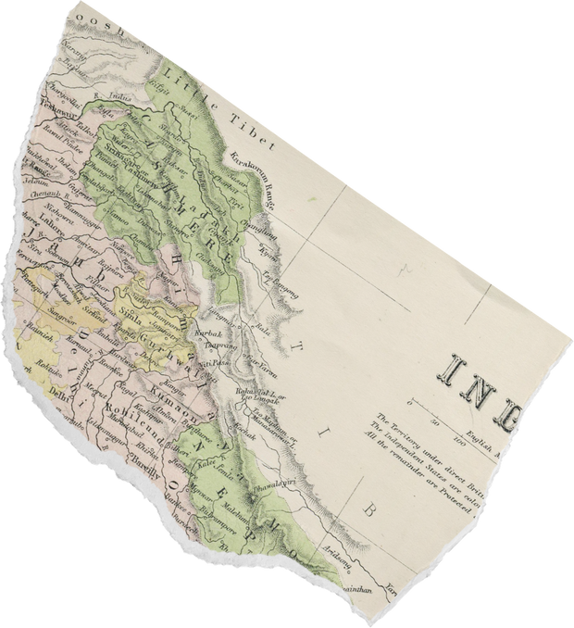
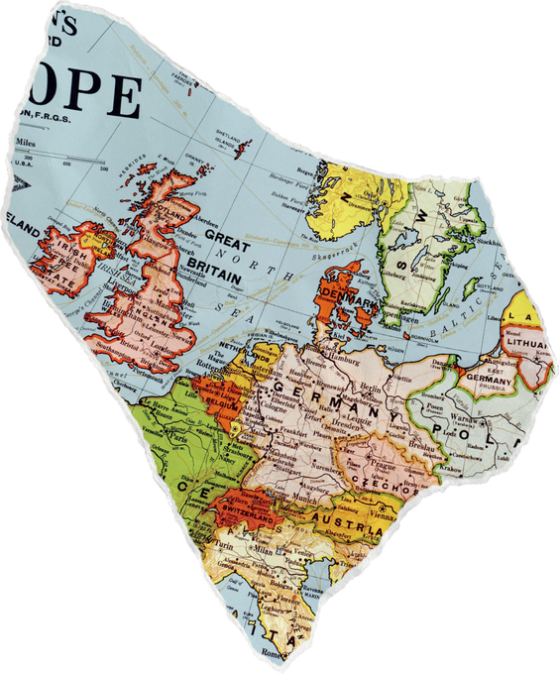
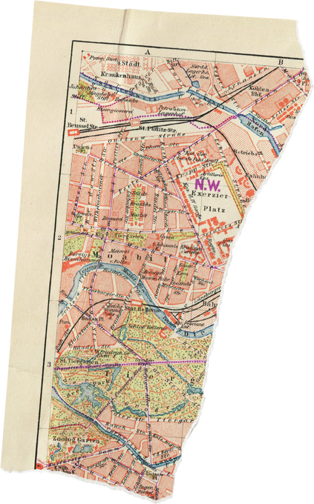
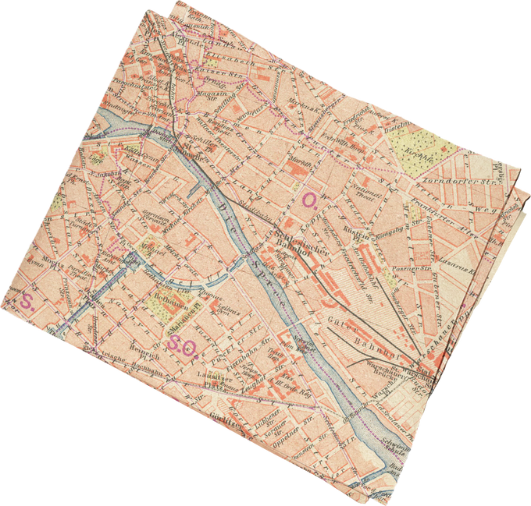
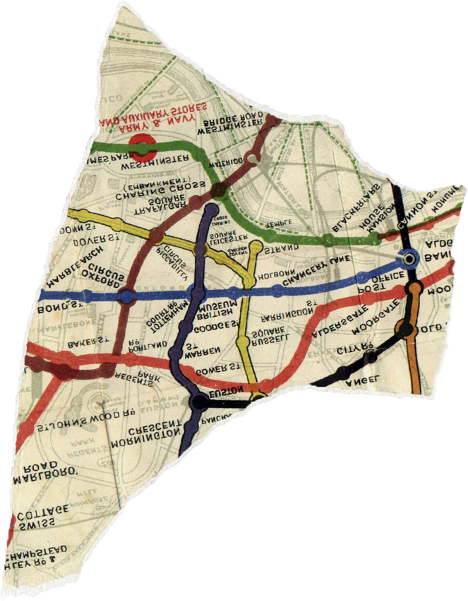
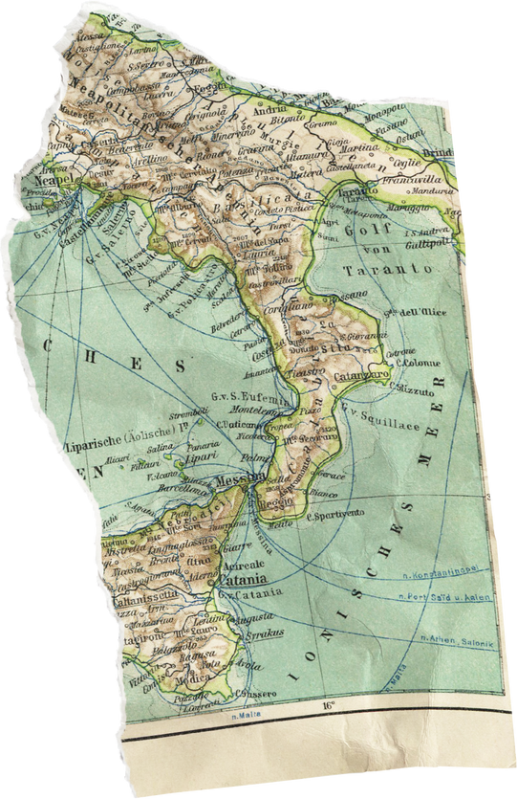

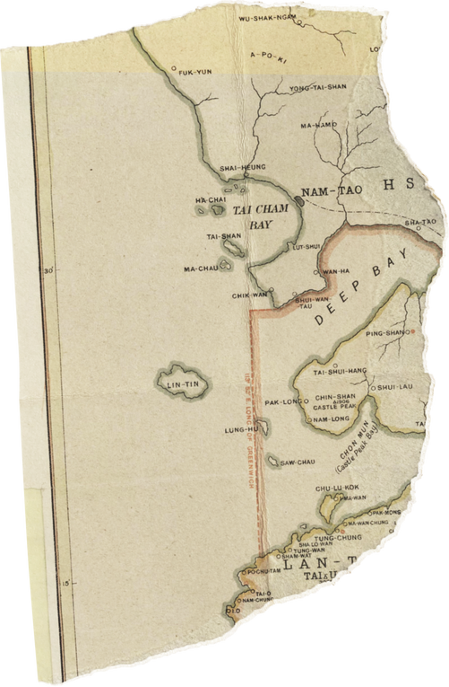
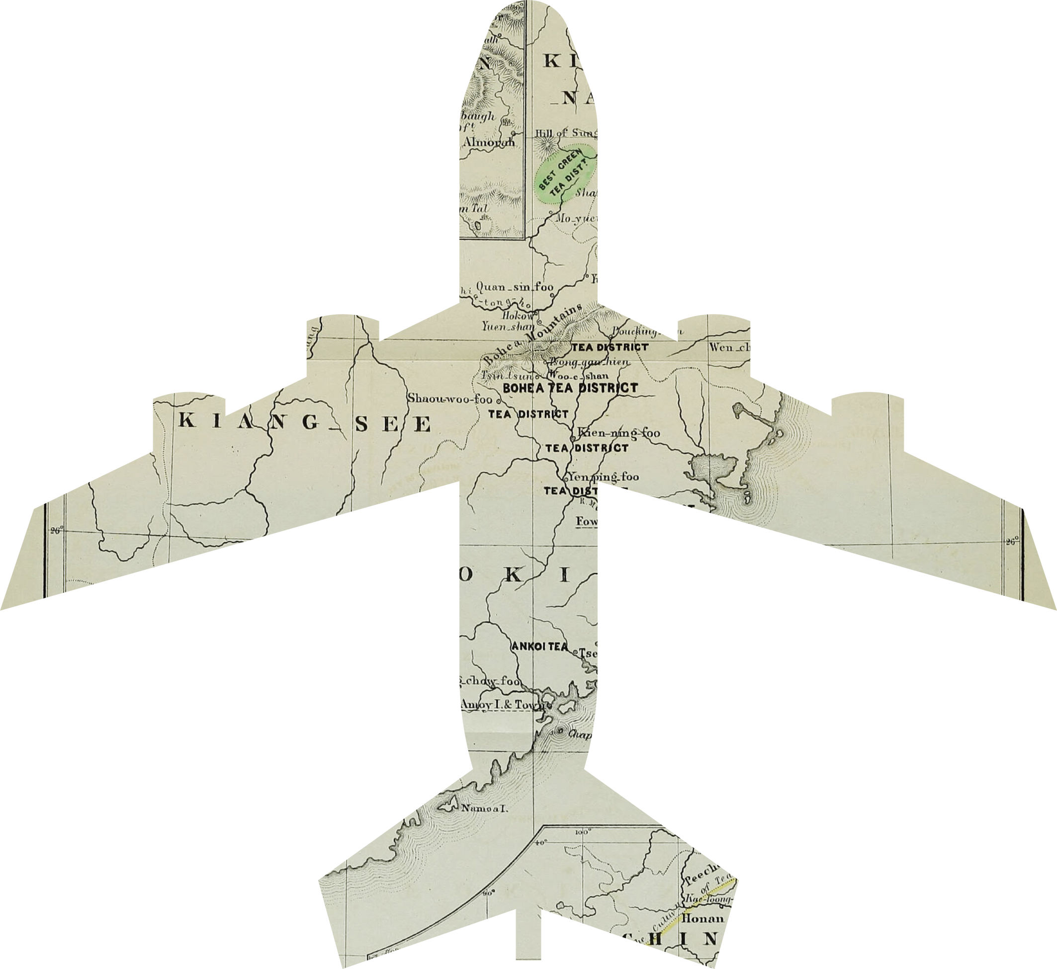

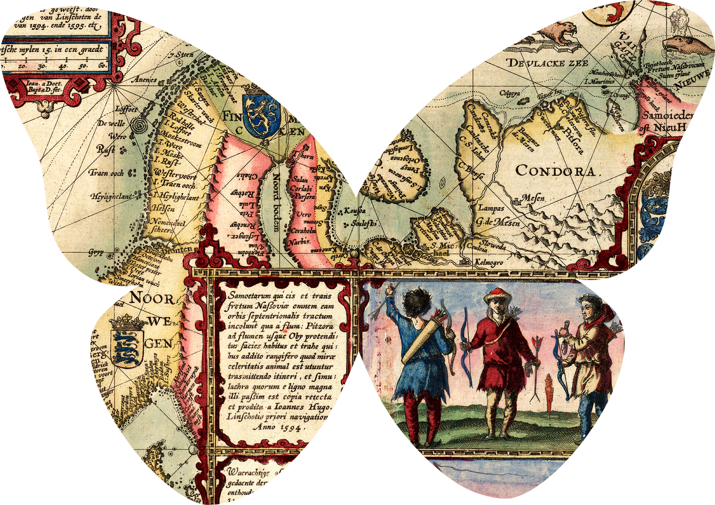
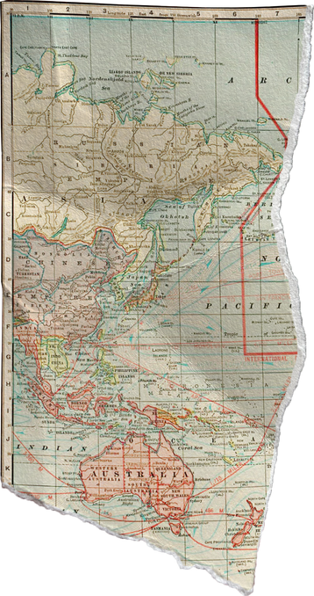
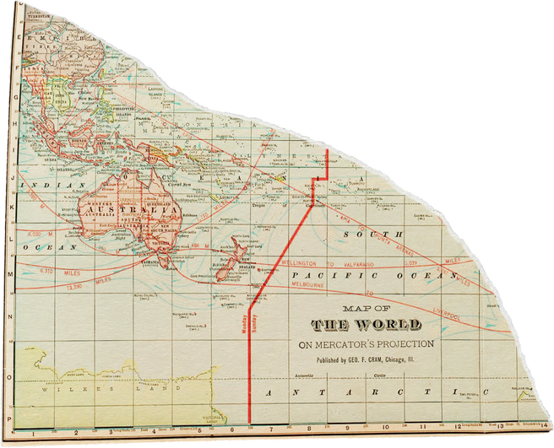
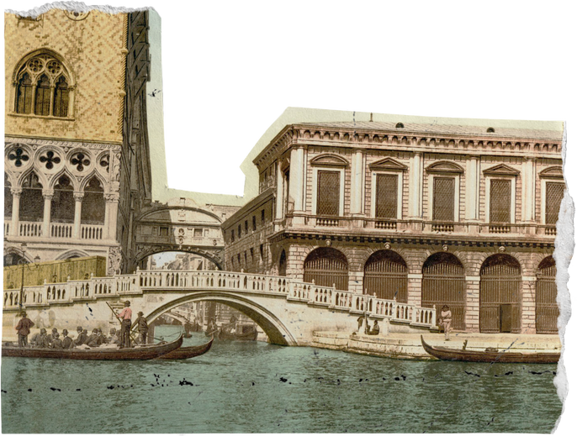
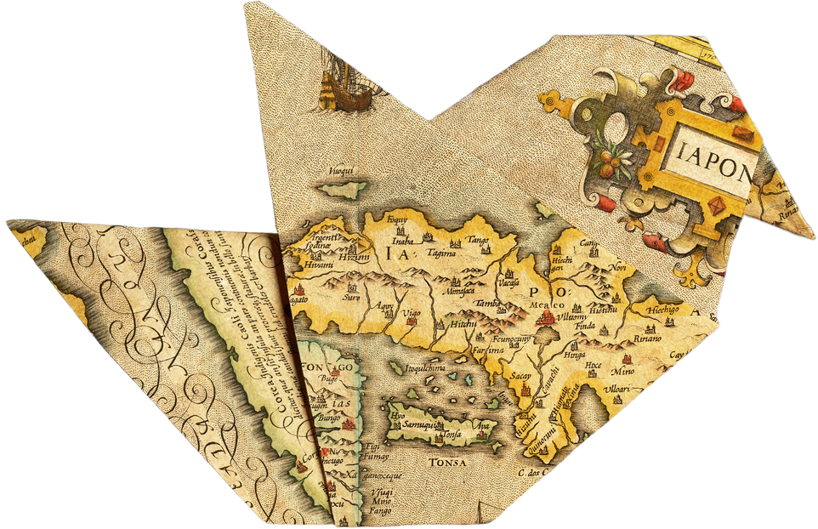

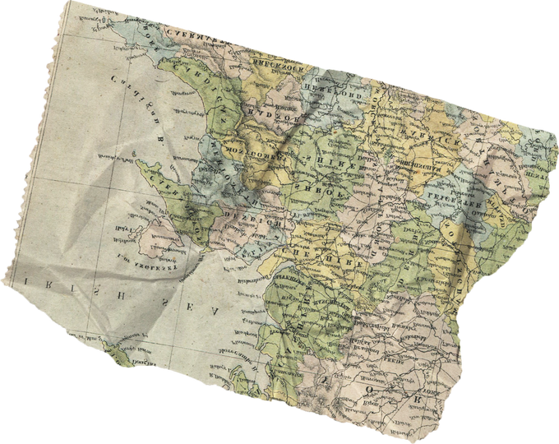
SAFAR SAATHI
Presented by Octagram

Slide 2
What is Safar Saathi?
Safar Saathi is your Personal AI travel assistant that can make a personalized and efficient travel itinerary for all the places you want to visit in India.
Leveraging AI and ML technologies we save your time as well as cater to your personal preferences to create the perfect travel plan for you.
Furthermore we also provide services such as suggesting places nearby, virtual tours, 2FA(two-factor-authentication) & re-captcha for security as well as a handy chatbot for your doubts.

Slide 3
What’s our recipie?
VCS
5%
Design
5%
We plan to use the following techstacks to build Safar Saathi:
Design/wireframe: Figma, Adobe Photoshop, draw.io.
2. Frontend: React, HTML, CSS, JavaScript, Material UI, Flask
3. AI/ML: Python, NumPy, Pandas, LLM(DaVinci AI),
ScikitLearn, MatPlotLib, PyTorch.
4. Backend/Cloud: Node.js , AWS (DynamoDB, Lamda),
GCP(Maps API), RestAPI.
5. Version Control System: Git, GitHub
Frontend
20%
Backend
30%
AI/ML
40%

Slide 4
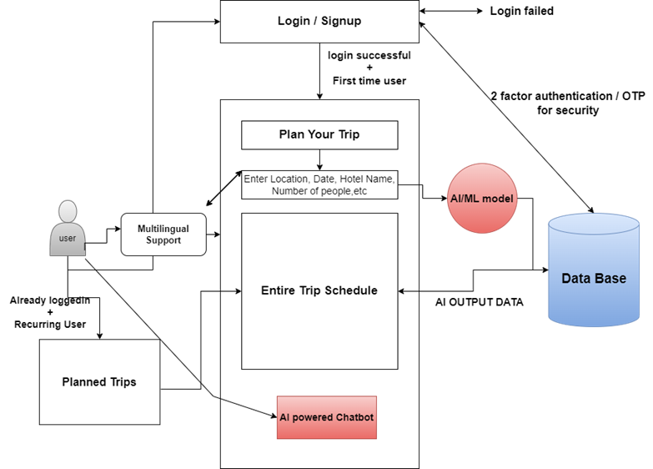
Our gameplan
At first we will design the wireframe then will design the frontend using react. There will be several python script files responsible for the generated itinerary and major operations. Our main database will be DynamoDB, AWS and several API actions will be called/triggered with the help of GCP services. For smooth development process and VCS GitHub will be preferred.
We will be providing virtual tour of the locations the users wants to visit to provide a better insight of their plans. We plan to provide an AI powered chatbot for tour guidance with multilingual support. We save time while also providing an efficient, customized and smooth experience for your wonderful trip.

Slide 5


Meet our Pilots
ARCHISMWAN CHATTERJEE
KRISHNAVA GHOSH
ANKIT DAS
ESHAN DAS
KARAN KAWATHIA

Slide 6
Thank you very much!

